Slide 1


Slide 2
Graphics Programming on the Web with WebCL
Mikaël Bourges-Sévenier, Motorola Mobility
August 9, 2012
Notes:
Welcome to Graphics programming on the Web using the upcoming standard from Khronos Group: WebCL.

Slide 3
Over 32000 planks ;-) Blender/Bullet/SmallLuxGPU OpenCL
By Alain Ducharme “Phymec” http://www.youtube.com/watch?v=143k1fqPukk
Notes:
This demonstration is not working on a browser but uses OpenCL to speedup physics computations for the position of all the planks.
Our goal with WebCL is to be able one day to perform such computations on your web browser.

Slide 4

Motivation
For compute intensive web applications
Games: physics, special effects
Computational photography
Scientific simulations
Augmented reality
…
Use many devices for general computations
CPU, GPU, DSP, FPGA…

Slide 5
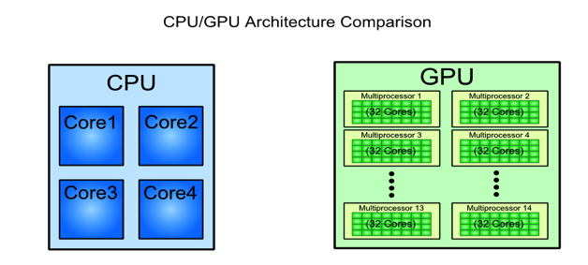
Motivation
GPUs provide exponential GFLOPS growth every year vs. CPUs
NVidia CUDA/OpenCL C programming guide
Notes:
While CPU tend to have 2 to 32 cores, GPU have much more.

Slide 6


Content
Motivation and Goals
General-Purpose computations on GPU (GPGPU)
From to
The need for more general data-parallel computations
WebCL overview
A JavaScript API over OpenCL
OpenCL concepts
WebCL API
WebCL programming
Pure computations
WebGL interoperability

Slide 7
Content
Motivation and Goals
General-Purpose computations on GPU (GPGPU)
From to
The need for more general data-parallel computations
WebCL overview
A JavaScript API over OpenCL
OpenCL concepts
WebCL API
WebCL programming
Pure computations
WebGL interoperability

Slide 8

WebGL pipeline
Programmable vertex & fragment shaders
Notes:
Historically, when GPU became programmable, people try to use vertex and fragment shader programs to perform more general computations than rendering vector graphics.

Slide 9
General Purpose computations on GPU
With clever mapping of algorithms to GL pipeline
Textures as data buffers
Texture coordinates as computational domain
Vertex coordinates as computational range
Vertex shaders
to start computations
scatter operations
Fragment shaders
for algorithms steps
gather operations
Scatter (write values)
Gather (read values)
Notes:
The scatter & gather operations are fundamental operations for GPGPU. Typically, scatter is difficult because in a graphics pipeline the fragment shader is called for writing one output value. One can still perform scatter using vertex shaders cleverly. Newer versions of graphics API & drivers provide specific methods for scatter.
Gather is no brainer since it can be achieved by reading textures.

Slide 10
GPGPU with GL limitations
Hard to map algorithms to graphics pipeline
Hard to do scatter operations
Shader instances can NOT directly communicate with one another
… GPGPU with GL is hack-ish
CL is made for GPGPU, not graphics

Slide 11
Content
Motivation and Goals
General-Purpose computations on GPU (GPGPU)
From to
The need for more general data-parallel computations
WebCL overview
A JavaScript API over OpenCL
OpenCL concepts
WebCL API
WebCL programming
Pure computations
WebGL interoperability

Slide 12
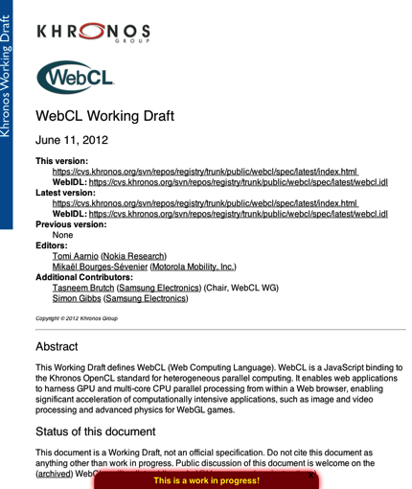

WebCL overview
WebCL brings parallel computing to the Web through a secure JavaScript binding to OpenCL 1.1 (2011)
Open standard, royalty-free
Platform independent
Device independent
being standardized by Khronos
First public working draft April 2012
http://www.khronos.org/webcl/

Slide 13
OpenCL overview
Features
C-based cross-platform API
Kernels use a subset of C99 and extensions
Vector extensions (<type>N)
No recursion, no function pointers
No dynamic memory (malloc, free…), no standard libc methods (memcpy…)
Well-defined numerical accuracy both for intergers and floats
Rich-set of built-in functions (e.g. as GLSL and more)
But no random method
Close to the hardware
Control over memory use
Control over thread scheduling

Slide 14

OpenCL Device Model
A host is connected to one or more Compute devices
Compute device
A collection of one or more compute units (~ cores)
A compute unit is composed of one or more processing elements (~ threads)
Processing elements execute code as SIMD or SPMD

Slide 15

OpenCL Execution Model
Kernel
Basic unit of executable code (~ DLL entry point)
Data-parallel or task-parallel
Program
Collection of kernels and functions called by kernels
Analogous to a dynamic library (DLL)
Command Queue
Control operations on OpenCL objects (memory transfers, kernels execution, synchronization)
Commands queued in order
Execution in-order or out-of-order
Applications may use multiple command-queues per device
Work-item
An execution of a kernel by a processing element (~ thread)
Work-group
A collection of work-items that execute on a single compute unit (~ core)
GPU
CPU
Context
Queue
Queue

Slide 16


OpenCL Work-group 2D analogy
Local
Global
# work-items = # pixels
# work-groups = # tiles
Work-group size = tileW * tileH
All threads in a workgroup run
synchronously
Notes:
To understand work-groups and work-items, suppose you have a matrix or an image to process. The image can be decomposed into tiles and each tile can be processed independently.
A tile would be a work-group. Inside this work-group, each pixel would be processed by a work-item.
Unlike typical CPU multithreading, all work-items (or threads) execute synchronously, thanks to the SIMD nature of GPUs. This has an important consequence: if each thread execute the same number of operations them they will complete at the same time. But if one is taking longer than other threads, e.g. due to branch divergence (like an if…else clause), then other threads will wait until it finishes its operations, thereby slowing down effective computational throughput.

Slide 17
OpenCL Memory Model
On Host
CPU RAM
On Compute Device
Global memory = GPU RAM
Constant memory = cached global memory
Texture memory = cached global memory optimized for streaming reads
Local memory = high-speed memory shared among work-items of a work-group (~ L1 cache)
Private memory = registers of a work-item, very fast memory
Memory management is explicit
App must move data host ➞ global ➞ local and back
Notes:
Developers must manage memory explicitly. For best performance increase, move data closer to the cores. However, be aware that the closer you get to cores, the smaller the memory available.

Slide 18
OpenCL Kernel
Defined on a N-dimensional computation domain
A kernel is executed at each point of the computation domain
Notes:
For 1-Dimensional problems, in a sequential language like JavaScript, one would use a for loop to iterate across the 1D array.
With CL, we tell the device to iterate over a 1-D domain and only provide the core of the loop. When CL calls the kernel, it provides methods to query which index (i.e. thread) is executing the kernel.
By extension, for 2D problems, in JavaScript, we would have 2 imbricated for loops. CL’s work-items are going to iterate over the 2D domain and (x,y) index of the thread calling a kernel is provided by get_global_id(dimension), with dimension = 0 (1st dimension), or 1 (2nd dimension).

Slide 19
WebCL API
Same OO model as OpenCL
with JS classes
WebCL is global object
Notes:
WebCL object cannot be constructed with new operator. It is like the Math object of JavaScript.

Slide 20
Content
Motivation and Goals
General-Purpose computations on GPU (GPGPU)
From to
The need for more general data-parallel computations
WebCL overview
A JavaScript API over OpenCL
OpenCL concepts
WebCL API
WebCL programming
Pure computations
WebGL interoperability

Slide 21
WebCL sequence (host side)
Create context
Compile kernels
Setup command-queues
Setup kernels arguments
Execute commands
Read results

Slide 22
WebCL sequence (host side)

Slide 23
WebCL sequence (host side)
Notes:
----- Meeting Notes (8/2/12 16:54) -----
kernels can come from anywhere

Slide 24
WebCL sequence (host side)

Slide 25
WebCL sequence (host side)

Slide 26
WebCL sequence (host side)
Note: Use local work size = [] or null (default) to let driver chose the best values.

Slide 27
WebCL sequence (host side)

Slide 28
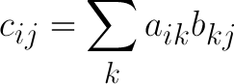
Example: Matrix multiplication
“Hello World of CL”
C = A x B
N x N matrices
Notes:
While we explain how to setup a simple vector multiplication kernel, this would apply to matrices too. Matrix multiplication is probably what I would call the best “Hello World” example for compute languages.

Slide 29
Example: Matrix multiplication
Optimization
N x N matrices
C divided into m x m tiles
With
m = N / P
P = # threads per workgroup (16)
Notes:
To optimize computations, recall the work-group/work-item analogy we explained earlier with an image. We said that work-groups are tiles onto which work-items operate.
Here we do exactly that with P work-items (or threads) per work-group. Use WebCLKernel.getWorkGroupInfo(WebCL.KERNEL_PREFERRED_WORKGROUP_SIZE) to find out what this number is for a device. It is typically a power of 2 like 16, 32, 64.

Slide 30
Example: Comparison with sequential
MacBook Pro (early 2011), OSX 10.8
CPU: Intel Core i7, 2.2GHz, 4 cores
GPU: AMD Radeon HD 6750M, 1 GB, 480 SPU, 600 MHz, 576 GFLOPS
Notes:
However, that CPU being hyperthreaded, it is seen as 8 cores rather than 4.
On this machine, the preferred workgroup size multiple is 1 for CPU, 64 for GPU. The maximum workgroup size is 128 for CPU, 256 for GPU. So we set the local workgroup size to 128x1 (=128) for CPU and 16x16 (=256 and divisible by 64) for GPU.
As you can see, the performance of CL on CPU is pretty good and even better than GPU for small matrix sizes, less than 512x512. As the matrix size grow, the CPU performance remains constant but the GPU performance grows exponentially; as expected.
Note: the OpenMP code uses the same tiling optimization as for GPU with 8 threads.
If you recall the video at the beginning of this course, the physics engine is essentially doing matrix/vector multiplication for 32k items. With these results, a tremendous speedup can be achieved compared to a CPU approach.

Slide 31
WebCL / WebGL interop
WebCL context created from WebGL context
Configure shared CL objects from GL counterparts
Sync GL and CL
Flush GL, acquire GL object
Execute CL
Release CL object, flush CL
Vertex arrays, textures, render-buffers can be shared with CL
Notes:
----- Meeting Notes (8/2/12 16:54) -----
Vertex buffer objects

Slide 32
WebCL / WebGL interop

Slide 33
WebCL / WebGL interop (texture)

Slide 34
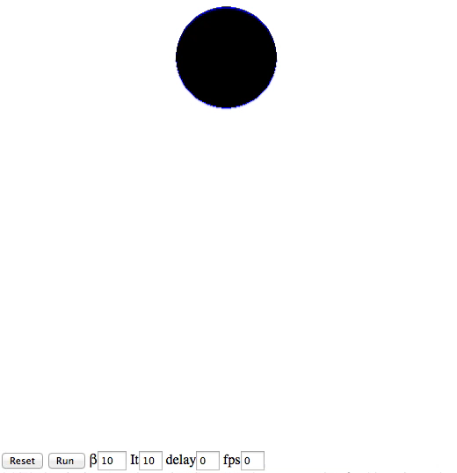
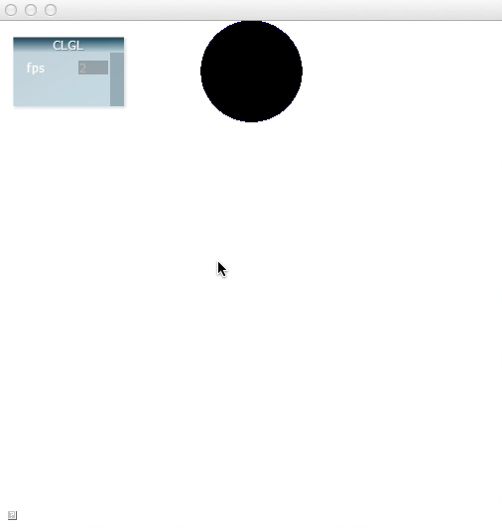
Demo: GL Texture update with CL
Based on Evgeny Demidov 2D ink droplet
WebGL ~26 fps
WebCL ~124 fps
Notes:
The CL and GL version use the same code. The CL version uses shared textures so there is no memory round trips between host and GPU, this explains the huge speedup.

Slide 35
WebCL / WebGL interop (vbo)

Slide 36
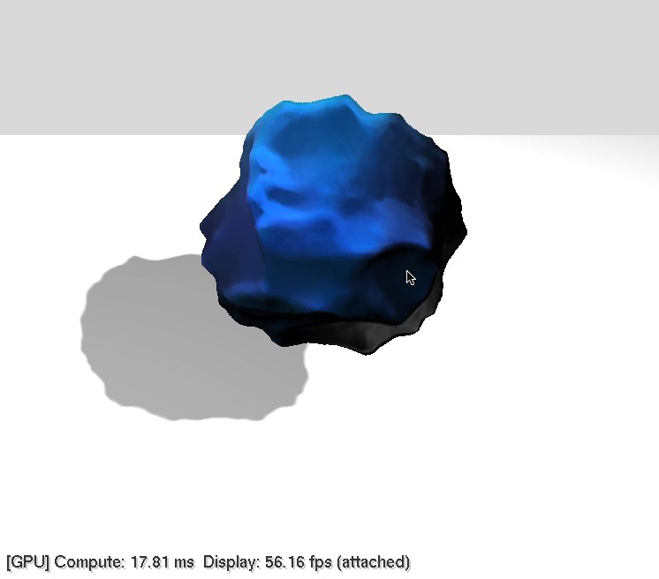
Demo: VBO update with CL
Notes:
This example comes from Nvidia CUDA/OpenCL SDK. A sphere is rendered by GL but the vertices’ positions are modified by CL with some noise to create this cool effect.

Slide 37
WebCL/WebGL interop (host side)
Notes:
This is the recommended way to synchronize GL and CL queue. However, there is a more optimal way using GL and CL events rather than flushing their queues. However, synchronization with events is an advanced subject we don’t have time to discuss in this course and you can found presentations online.

Slide 38
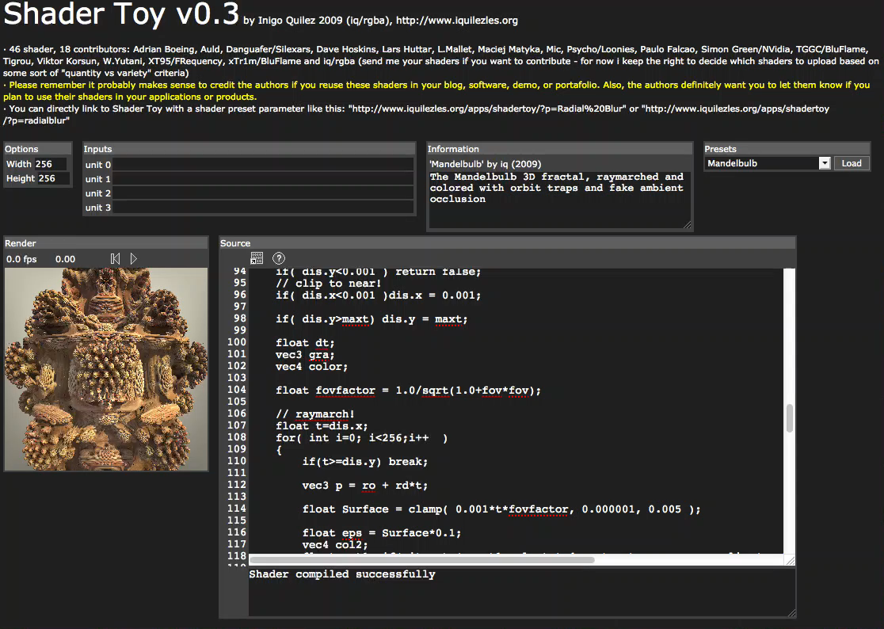
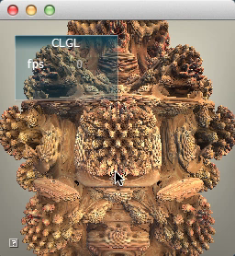
Demo: Texture update with CL
Based on Iñigo Quilez ShaderToy
WebGL ~6 fps
WebCL ~22 fps
Notes:
This example is in the course notes. The CL version uses the same code as the GL fragment shader. The differences are:
Use of optimized native methods eg native_cos() instead of cos()
Use of local memory to store intermediate data

Slide 39
Perspectives
WebCL enables GPGPU applications in Web browsers
Careful usage of architecture can lead to impressive speedup
With WebGL interoperability, rich graphics Web applications are now possible
DRAFT WebCL specification
Quite stable JavaScript API
Focusing on more security and robustness

Slide 40
WebCL Open process and Resources
Khronos open process to engage Web community
Public specification drafts, mailing lists, forums
http://www.khronos.org/webcl/
webcl_public@khronos.org
Nokia open source prototype for Firefox in May 2011 (LGPL)
http://webcl.nokiaresearch.com
Samsung open source prototype for WebKit in July 2011 (BSD)
http://code.google.com/p/webcl/
Motorola open source prototype for NodeJS in March 2012 (BSD)
https://github.com/Motorola-Mobility/node-webcl
Notes:
The Khronos web site has a wiki with links to all these WebCL implementation prototypes. On this web site, you will also find links to this presentation, course notes, and updates.
All examples in this course were done with node-webcl from Motorola and rendered with node-webgl, both are freely available on github. While this is not an implementation within a web browser, it uses the same JavaScript engine as Chrome/Chromium browsers i.e. Google v8 engine. We use nodejs for server-side processing and the same code is being ported to Chrome browser. Using nodejs we can prototype new features quickly before adding them to browsers.

Slide 42

This slide has a 16:9 media window

Slide 43




Start learning Now!
OpenCL Programming Guide - The “Red Book” of OpenCL
http://www.amazon.com/OpenCL-Programming-Guide-Aaftab-Munshi/dp/0321749642
OpenCL in Action
http://www.amazon.com/OpenCL-Action-Accelerate-Graphics-Computations/dp/1617290173/
Heterogeneous Computing with OpenCL
http://www.amazon.com/Heterogeneous-Computing-with-OpenCL-ebook/dp/B005JRHYUS
The OpenCL Programming Book
http://www.fixstars.com/en/opencl/book/

